Slide 1
Computer Vision

Slide 2
Group Members
Mg Min Han Set Naing KPTMYK-001298
Ma Pann Cherry Myo KPTMYK-001288
Ma May Thiri Paing KPTMYK-001285
Ma Wa Thone Tha Zin KPTMYK-001286
Ma Thin Nandar Hsu KPTMYK-001330

Slide 3
Outlines
What is Computer Vision?
How does Computer Vision work?
Application of Computer Vision?
Computer Vision in Food Recognition
Computer Vision in Image Recognition
Computer Vision in Motion Analysis & Tracking
Advantages and Disadvantages
Benefits of Computer Vision

Slide 4
What is Computer Vision?
Computer Vision (CV) is a scientific and engineering field within Artificial Intelligence (AI) that focuses on enabling computers to acquire, process, analyze, and understand visual information from digital images and videos in order to extract meaningful facts and make decisions.

Slide 5
How does Computer Vision work?
Computer Vision is a technology that enables computers to “see” and understand images like the human eye. It takes photos or videos as input and processes them using AI techniques to automatically identify objects, people, and food items. In Food Recognition, Computer Vision can classify food images and estimate their calories and nutritional values, making it useful for diet control, health monitoring, fitness apps, and nutrition research.

Slide 6
Application of Computer Vision?
In Food Recognition
In Image Recognition
In Motion Analysis & Tracking

Slide 7

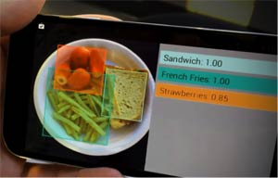
Computer Vision in Food Recognition
Food Recognition is a computer vision technology used to identify food from images or videos.
It uses Artificial Intelligence (AI) and Deep Learning methods.
Convolutional Neural Networks (CNNs) are commonly used for food recognition.
The system analyzes visual features such as:
Color
Shape
Texture
Based on these features, the model classifies the type of food shown in the image.

Slide 8
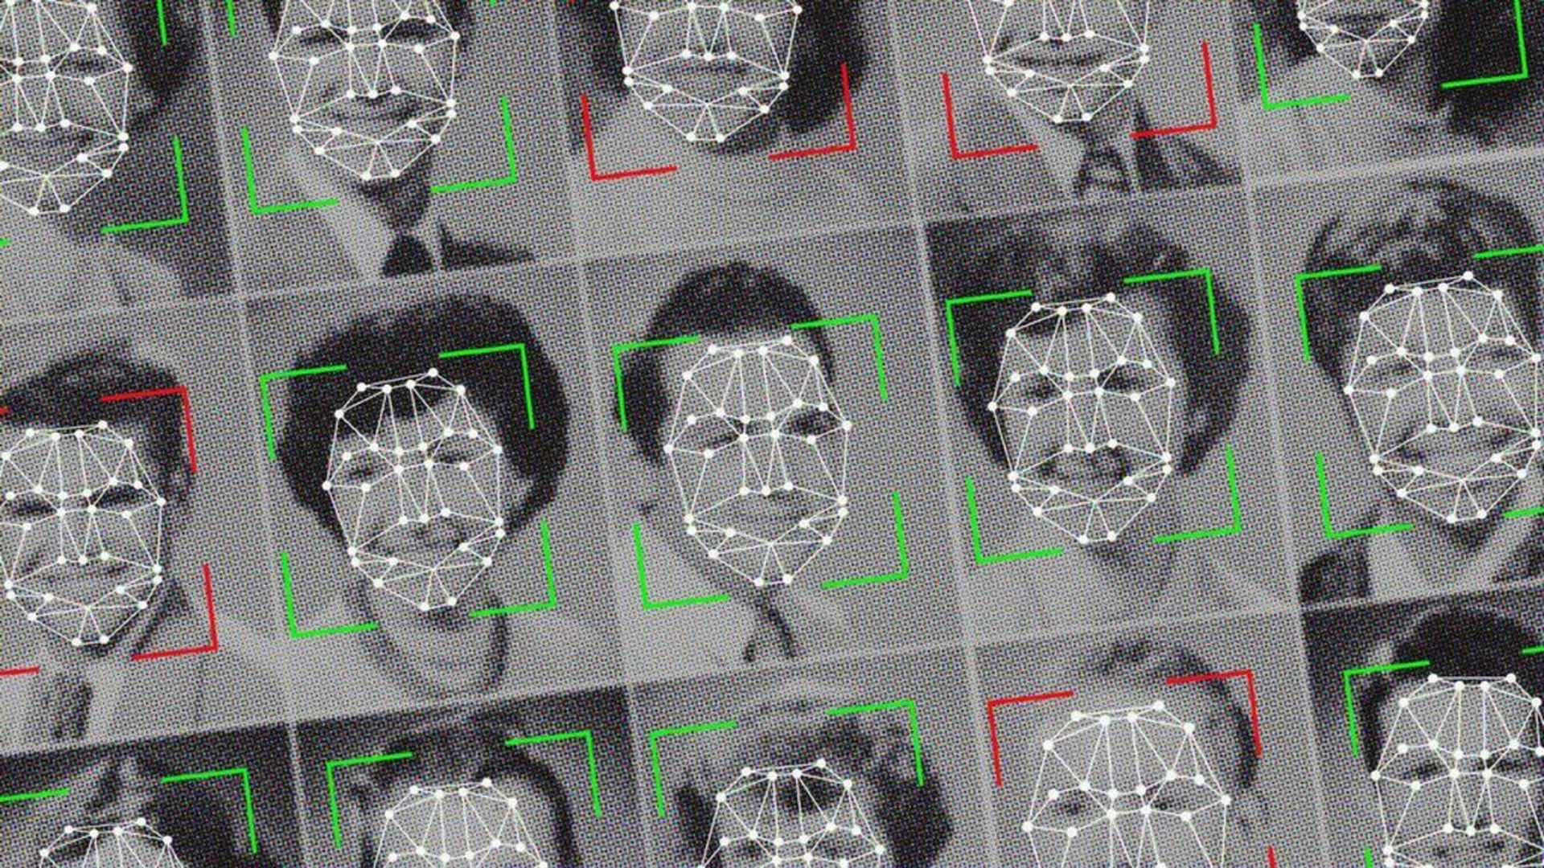
Computer Vision in Image Recognition
Image recognition is a technology that enables computers or machines to identify and understand objects, people, text, or features within digital images or videos automatically.
simple terms, it’s like teaching a computer to "see" and "recognize" what’s in a picture—whether that’s a face, a car, a handwritten number, or anything else.
This is usually done using artificial intelligence techniques such as machine learning and deep learning, where the system learns from lots of example images to figure out patterns and features that help it recognize new images it hasn’t seen before.

Slide 9
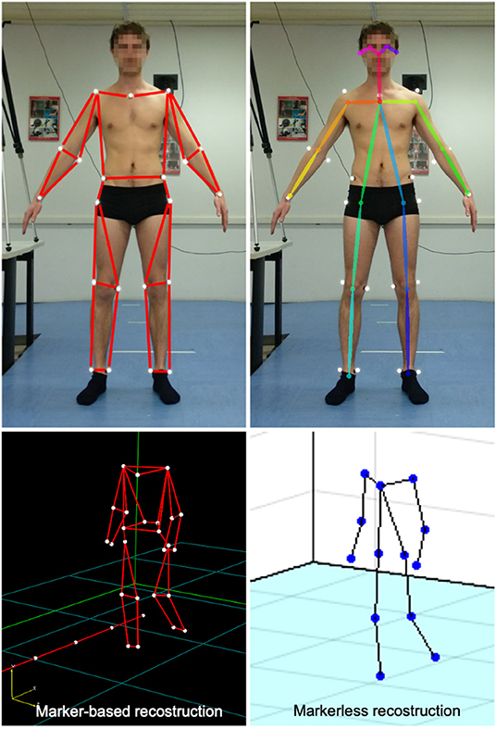
Computer vision in Motion Analysis & Tracking
Motion Analysis and Tracking refers to the automatic and systematic observation, recording, and study of moving objects, people, or items within images or videos.
To understand information such as the position, trajectory, speed, and movement patterns of a moving object.
It is used in motion-related technologies, behavior prediction, sports coaching, security systems, and film/game production.
Detection — Identifying moving objects within the video.
Tracking — Continuously locating the objects from one frame to the next to determine their path of movement.
Analysis — Using the collected motion data to interpret behaviors, patterns, speed, and more.

Slide 10
Advantages and Disadvantages
Advantages
While generally harmful, computer viruses can be useful in controlled environments such as research labs, virus analysis, and cybersecurity training:
Security Testing: Can be used to test antivirus software and network security systems.
Awareness & Education: Helps users learn safe computing practices and understand cybersecurity risks.

Slide 11
Advantages and Disadvantages
Disadvantages
Data Loss
System Failure (System Crash)
Loss of Personal Data Security
Internet/Network Disruption
Financial Loss
Time Wastage

Slide 12
Benefits of Computer Vision
Computer Vision enables tasks to be performed automatically, reduces human errors, and provides accurate and consistent results. It can process image and video data quickly in real-time and can monitor dangerous environments without human presence. Additionally, it allows for data collection such as object detection, pattern recognition, and trend analysis, and can be widely applied in fields like healthcare, security, retail, food recognition, and self-driving cars. Using this technology also reduces labor costs and improves operational efficiency.

Slide 13
